Slide 1
recursion
CITS1001

Slide 2
Scope of this lecture
Concept of recursion
Simple examples of recursion
Pitfalls of recursion
Recursive data
Interesting examples of recursion
The text does not have a chapter on recursion
We recommend these notes from Princeton:
http://introcs.cs.princeton.edu/java/23recursion/
Some examples in these notes are sourced from there

Slide 3
Recursion
We have already seen that a method can call other methods
Either in the same class or in other classes
However a method can also call itself
This self-referential behaviour is known as recursion
Recursion is a powerful technique for expressing certain complex programming tasks
It provides a very natural way to decompose some problems
There are computational costs and other potential pitfalls associated with recursion
The careful programmer will always be aware of these

Slide 4
The simplest example
The factorial of a positive integer k is the product of the integers between 1 and k
k! = 1 × 2 × 3 × … × (k–1) × k
In Java:
private long factorial(long k)
{
long z = 1;
for (long i = k; i > 1; i––) z *= i;
return z;
}

Slide 5
Think different!
k! = 1 × 2 × 3 × … × (k–1) × k
∴ (k–1)! = 1 × 2 × 3 × … × (k–2) × (k–1)
k! = [1 × 2 × 3 × … × (k–1)] × k
∴ k! = (k–1)! × k
This is a recursive definition of factorial
Factorial defined in terms of itself
It uses factorial to define factorial

Slide 6
Something else is required
4!
= 4 × 3!
= 4 × 3 × 2!
= 4 × 3 × 2 × 1!
= 4 × 3 × 2 × 1 × 0!
= 4 × 3 × 2 × 1 × 0 × (–1)!
…
We need something to tell it when to stop!
The base case of the recursion is when we know the result directly
1! = 1

Slide 7
Recursive factorial in Java
private long factorial(long k)
{
if (k == 1) return 1;
else return k * factorial(k – 1);
}
In the base case
factorial stops and returns a result directly
In the recursive case
factorial calls itself with a smaller argument

Slide 8
How does Java execute this?
private long factorial(long k)
{
if (k == 1) return 1;
else return k * factorial(k – 1);
}
24
factorial(4)
= 4 *
factorial(3)
6
factorial(3)
= 3 *
factorial(2)
2
factorial(2)
= 2 *
factorial(1)
1
factorial(1)
= 1

Slide 9
Every k is a local variable
Each invocation of factorial has its own independent parameter k
factorial(4) creates a local variable k = 4
Then factorial(3) creates its own local variable k = 3
Then factorial(2) creates its own local variable k = 2
Then factorial(1) creates its own local variable k = 1
The compiler manages all of these variables for you, behind the scenes
Exactly as if you called any other method multiple times
Each invocation would have its own local variable(s)

Slide 10
Ingredients for a recursive definition
Every recursive definition must have two parts
One or more base cases
Each base case represents some “trivial case”, where we return a result directly
These are essential so that the recursion doesn’t go on forever
Often either a number being 0 or 1, or an array segment having length 0 or 1, or an empty ArrayList, or …
One or more recursive cases
The result is defined in terms of one or more calls to the same method, but with different parameters
The new parameters must be “closer to” the base case(s) in some sense
Often a number getting smaller, or an array segment getting shorter, or two numbers getting closer together, or …

Slide 11
Multiple base cases
Each Fibonacci number is the sum of the previous two Fibonacci numbers
F₁ = 1
F₂ = 2
F_{k} = F_{k–1} + F_{k–2}, if k ≥ 3
1, 2, 3, 5, 8, 13, 21, 34, 55, …

Slide 12
Fibonacci in Java
private long fib(long k)
{
if (k == 1) return 1;
else
if (k == 2) return 2;
else return fib(k – 1) + fib(k – 2);
}
This version is appalling slow, though
The number of calls to calculate fib(k) is F_{k}

Slide 13
Faster Fibonacci
private long fib1(long k)
{
return fib2(k, 1, 1);
}
private long fib2(long k, long x, long y)
{
if (k == 1) return x;
else return fib2(k – 1, x + y, x);
}
The number of calls to calculate fib1(k) is k–1
Make sure you understand that fib1(k) = fib(k)

Slide 14
Really fast Fibonacci
private long fib3(long k)
{
double sq5 = Math.sqrt(5);
double phi = (1 + sq5) / 2;
return Math.round(Math.pow(phi, k + 1) / sq5);
}
Constant time!
Make sure you understand that fib3(k) = fib(k)

Slide 15
Binary search
Linear search means searching a data structure by inspecting every element in turn
This is very slow for large data
If the data is sorted, we can use the much faster binary search
Assume we are given an array of numbers in ascending order, and we want to check if the number z is in the array
Inspect the middle number
If z is bigger than the middle number, then if z is in the array, it must be in the top half
All numbers in the bottom half are smaller than z and can be ignored
If z is smaller than the middle number, then if z is in the array, it must be in the bottom half

Slide 16
Code for binary search
// search a for z
public static boolean binarySearch(int[] a, int z) {
return bs(a, 0, a.length - 1, z);
}
// search a[l..u] inclusive for z
private static boolean bs(int[] a, int l, int u, int z) {
if (l == u)
return a[l] == z;
else
{
int m = (l + u) / 2;
if (z > a[m]) return bs(a, m + 1, u, z);
else return bs(a, l, m, z);
}
}

Slide 17
Binary search in action
Searching for 29
3
5
6
11
12
14
17
20
26
28
31
32
35
39
41
Not found!

Slide 18
Performance of binary search
Binary search is fast because in each recursive call, the size of the array that must be searched is reduced by a factor of two
So there will be at most log₂n+1 calls, where n is the size of the original array
e.g. for an array of size 1,000, only 11 items must be inspected
e.g. for an array of size 1,000,000, only 21 items
e.g. for an array of size 1,000,000,000, only 31 items
The base case is guaranteed to be hit because in each recursive call, the array segment gets smaller
u–l defines the length of the array segment still to search
u–l gets smaller in each call
When u–l hits 0, we use the base case

Slide 19
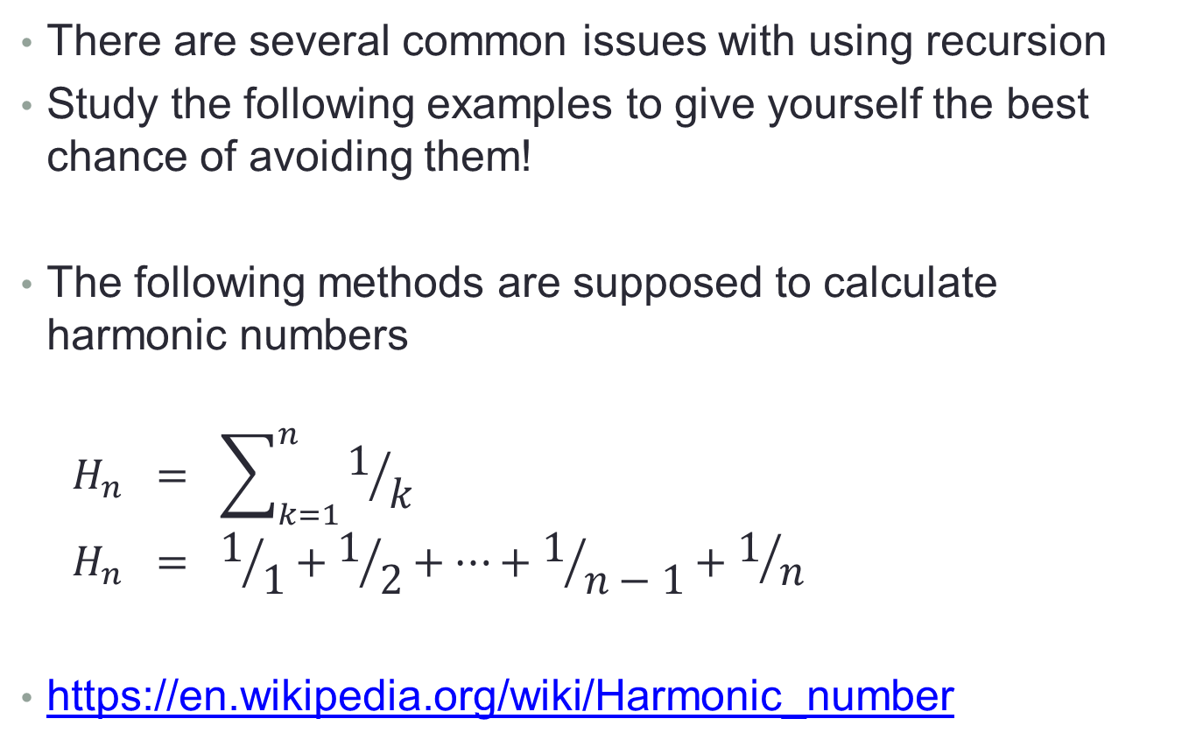
Potential pitfalls of recursion
There are several common issues with using recursion
Study the following examples to give yourself the best chance of avoiding them!
The following methods are supposed to calculate harmonic numbers
$$H_{n} = \sum_{k=1}^{n}{1/k}$$
$$H_{n} = 1/1+1/2+…+1/{n−1}+1/n$$
https://en.wikipedia.org/wiki/Harmonic_number

Slide 20
No base case(s)
This version of harmonic has the recursive case correct
However it has no base case
It will repeatedly call itself forever
This is known colloquially as an “infinite loop”
Eventually it will crash with a stack overflow error
private double harmonic(int n)
{
return harmonic(n-1) + 1.0/n;
}

Slide 21
No guarantee of convergence
This version of harmonic has a correct base case, but the recursive case is incorrect
The recursive argument is not smaller than the original call
It will go into an infinite loop for any argument except 0
private double harmonic(int n)
{
if (n == 0) return 0;
else return harmonic(n) + 1.0/n;
}

Slide 22
Components in the wrong order
This version of harmonic has the right components, but in the wrong order
The test for base case or recursive case must come first
private double harmonic(int n)
{
return harmonic(n-1) + 1.0/n
if (n == 0) return 0;
}

Slide 23
Not hitting base case(s)
This version of harmonic tries to be clever and do two steps together
This works for even n, but it fails for odd n
Odd n generates recursive calls with odd arguments and so misses 0
And anyway it’s more complicated than it needs to be
private double harmonic(int n)
{
if (n == 0) return 0;
else return harmonic(n-2) + 1.0/(n-1) + 1.0/n;
}

Slide 24
Excessive memory requirements
This version of harmonic is correct
But if we call it with a very large argument, it may still cause a stack overflow error
Each recursive invocation consumes memory inside the system
Too much memory consumed and the system fails
private double harmonic(int n)
{
if (n == 0) return 0;
else return harmonic(n-1) + 1.0/n;
}

Slide 25
Excessive recomputation
This version of fibonacci from earlier is correct
But it involves a huge amount of repeated calculation
Try tracing it for k = 7
It will fail for any significant value of k
Recursion often hides such recomputation
private long fib(long k)
{
if (k == 1) return 1;
else
if (k == 2) return 2;
else return fib(k-1) + fib(k-2);
}

Slide 26
Recursive data
Consider a class that describes the hierarchical structure of a company
Each person is an employee
Some employees supervise other employees
Who might supervise other employees…
Who might supervise other employees…
This has a natural recursive structure
How do we represent this in Java?

Slide 27
Employee data includes Employee
public class Employee
{
private int IDnumber;
private Employee supervisor;
private Employee[] staff;
}
Every person in the company is an employee
Every person has a supervisor(?)
Every person has zero or more underlings that they manage directly
Each of those underlings is an employee, with a supervisor and underlings…

Slide 28
An organisational chart
Alf
Betty
Charles
Diane
Ethel
Fred
George
Hilary
Imogen
Jack
Keith
Lucy
Mark
Nora

Slide 29
Employee objects
Every person in the company is represented by an Employee object
supervisor = null
staff[0] = Betty
staff[1] = Charles
staff[2] = Diane
supervisor = Alf
staff[0] = Ethel
staff[1] = Fred
supervisor = Lucy
staff = null
Alf
Betty
Mark

Slide 30
Employee ranks
Every person in the company has a title, which reflects their standing relative to other people in the company
public String title()
{
if (supervisor == null)
return “President”;
else
return “Vice-” + supervisor.title();
}
Notice that the recursive call is to a different object

Slide 31
Cascading method calls
Alf.title() returns “President”
Betty.title() returns
“Vice-” + Alf.title()
which is “Vice-President”
Mark.title() returns
“Vice-”+Lucy.title()
which is “Vice-”+”Vice-”+Hilary.title()
which is “Vice-”+”Vice-”+”Vice-”+Diane.title()
which is “Vice-”+”Vice-”+”Vice-”+”Vice-”+Alf.title()
which is “Vice-Vice-Vice-Vice-President”

Slide 32
“Pass the buck”
In this situation, most method calls are achieved by simply “passing the buck”
i.e. asking another object to perform some calculation
Consider the problem of Alf trying to find out how many subordinates he has
Staff, staff-of-staff, staff-of-staff-of-staff, etc.
The “pass the buck” method is to
Ask Betty how many subordinates she has
Ask Charles how many subordinates he has
Ask Diane how many subordinates she has
Add those numbers together, and add three (for Betty, Charles, and Diane themselves)

Slide 33
The buck stops here
All recursion needs a base case, which stops the recursion and returns a result directly
In this case, it’ll stop at the bottom of the organisation
Someone with no underlings can just return 0
E.g. Ethel, Jack, Keith, etc.

Slide 34
In Java
public int subordinateCount()
{
if (staff == null) return 0;
int num = 0;
for (Employee e : staff)
num += 1 + e.subordinateCount();
return num;
}
Again, the recursive call is to a different object

Slide 35
Method structure follows data structure
In both of these methods, the structure of the data dictates the structure of the code
subordinateCount recurses down the hierarchy
Every path going down contributes to the result
title recurses up the hierarchy
The single path back to the root (Alf!) builds the result
Many, many algorithms traverse trees of data in this way
This “data structure implies code structure” pattern is much like how a 1D array implies the use of for loops and foreach loops

Slide 36
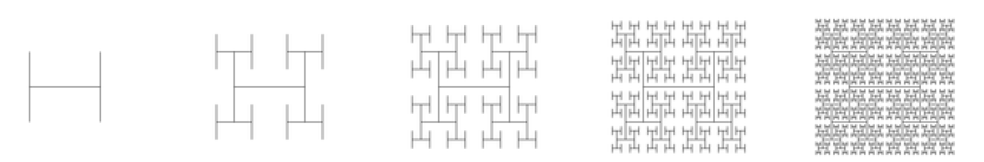
Recursive graphics
Simple recursive drawing schemes can lead to pictures that are remarkably intricate
e.g. an H-tree of order n and size s is defined as follows:
For n = 0, draw nothing
For n = 1, draw an H of size s
For n > 1, draw an H of size s plus four H-trees of order n–1 and size s/2, each one connected to a tip of the big H

Slide 37
Drawing an H-tree
// draw an H-tree of order n and size s centred at x,y
public void draw(int n, int x, int y, int s)
{
if (n == 0) return;
// draw the big H
drawH(x, y, s);
// compute the centres of the four half-size H-trees
int x0 = x - s / 2;
int x1 = x + s / 2;
int y0 = y - s / 2;
int y1 = y + s / 2;
// recursively draw four half-size H-trees of order n-1
draw(n-1, x0, y0, s / 2); // lower left H-tree
draw(n-1, x0, y1, s / 2); // upper left H-tree
draw(n-1, x1, y0, s / 2); // lower right H-tree
draw(n-1, x1, y1, s / 2); // upper right H-tree
}

Slide 38
Drawing an H
// draw an H of size s centred at x,y
public void drawH(int x, int y, int s)
{
// compute the coordinates of the four tips of the H
int x0 = x - s / 2;
int x1 = x + s / 2;
int y0 = y - s / 2;
int y1 = y + s / 2;
// draw the three line segments of the H
sc.drawLine(x0, y0, x0, y1); // left vertical segment
sc.drawLine(x1, y0, x1, y1); // right vertical segment
sc.drawLine(x0, y, x1, y); // horizontal segment
}

Slide 39
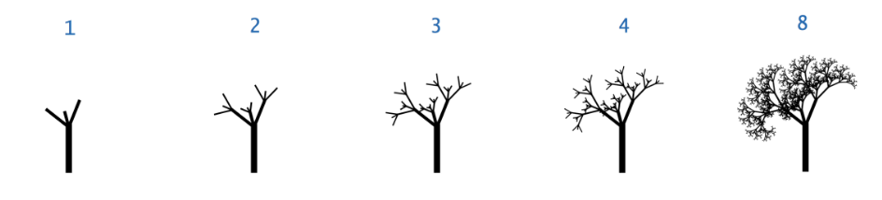
Recursive graphics
An H-tree is a simple example of a fractal
A fractal is a geometric shape where (some of) the components are reduced copies of the original
Challenge exercise: write a class that takes an argument n and draws recursive trees as shown below
Other challenges are available in the Princeton notes

Slide 40
A challenging example - counting combinations
Another common use of recursion is in enumerating combinations of possibilities
Consider partitioning a positive integer n into a sum of smaller positive integers
For example 4 could be partitioned in five ways
1 + 1 + 1 + 1
1 + 1 + 2
1 + 3
2 + 2
4
How many distinct ways can we do this for n?
http://en.wikipedia.org/wiki/Partition_%28number_theory%29

Slide 41
Partitions of n
Ultimately we want a method with the following signature that prints out all possible partitions of n
// list all ways of partitioning n into numbers
public static void listPartitions(int n)

Slide 42
Partitions of n into two numbers
Let’s start with a method that lists all partitions of n into exactly two numbers, e.g. for 7
1 + 6
2 + 5
3 + 4
We only want partitions where the numbers are in ascending order, otherwise we will generate duplicates
// list all ways of partitioning n into two numbers
public static void listParts2(int n)
{
for (int i = 1; i <= n / 2; i++)
System.out.println(i + " + " + (n - i));
}

Slide 43
Partitions of n into three numbers
Now consider partitions of n into exactly three numbers, e.g. for 7
1 + 1 + 5
1 + 2 + 4
1 + 3 + 3
2 + 2 + 3
// list all ways of partitioning n into three numbers
public static void listParts3(int n)
{
for (int i = 1; i <= n / 3; i++)
for (int j = i; j <= (n - i) / 2; j++)
System.out.println(i + " + " + j + " + " + (n-i-j));
}

Slide 44
Partitions of n into k numbers
For partitions of size two, we need one loop
For partitions of size three, we need two nested loops
For partitions of size four, we would need three nested loops
It gets ugly quickly!
And anyway, we need a general method

Slide 45
Partitions of n into k numbers
Recursion provides an elegant solution
The key observation is very simple
If p₁ + p₂ + … + p_{k} = n
(i.e. p₁ + p₂ + … + p_{k} is a partition of n)
Then p₂ + … + p_{k} = n – p₁
(i.e. p₂ + … + p_{k} is a partition of n – p₁)

Slide 46
Partitioning recursively
For example, consider the three partitions of 4 that start with 1
1 + 1 + 1 + 1
1 + 1 + 2
1 + 3
This simple observation is the foundation of a recursive algorithm
To partition n:
Set p₁ = 1 and find all partitions of n – 1
Set p₁ = 2 and find all partitions of n – 2 (with smallest number 2)
Set p₁ = 3 and find all partitions of n – 3 (with smallest number 3)
Etc.
These are the partitions of 3

Slide 47
Partitioning recursively in Java
// list all ways of partitioning n into numbers, given num numbers on ns
private static void listParts(int[] ns, int num, int n)
{
if (n == 0)
{
for (int i = 0; i < num - 1; i++)
System.out.print(ns[i] + " + ");
System.out.println(ns[num - 1]);
}
else
{
int min = num == 0 ? 1 : ns[num - 1];
for (int p = min; p <= n; p++)
{
ns[num] = p;
listParts(ns, num + 1, n - p);
}
}
}

Slide 48
Code dissection
// list all ways of partitioning n into numbers, given num numbers on ns
private static void listParts(int[] ns, int num, int n)
{
if (n == 0)
{
for (int i = 0; i < num - 1; i++)
System.out.print(ns[i] + " + ");
System.out.println(ns[num - 1]);
}
else
{
int min = num == 0 ? 1 : ns[num - 1];
for (int p = min; p <= n; p++)
{
ns[num] = p;
listParts(ns, num + 1, n - p);
}
}
}
The remaining number
The number of parts assigned so far
Parts assigned so far

Slide 49
Code dissection
// list all ways of partitioning n into numbers, given num numbers on ns
private static void listParts(int[] ns, int num, int n)
{
if (n == 0)
{
for (int i = 0; i < num - 1; i++)
System.out.print(ns[i] + " + ");
System.out.println(ns[num - 1]);
}
else
{
int min = num == 0 ? 1 : ns[num - 1];
for (int p = min; p <= n; p++)
{
ns[num] = p;
listParts(ns, num + 1, n - p);
}
}
}
The base case prints out a complete partition

Slide 50
Code dissection
// list all ways of partitioning n into numbers, given num numbers on ns
private static void listParts(int[] ns, int num, int n)
{
if (n == 0)
{
for (int i = 0; i < num - 1; i++)
System.out.print(ns[i] + " + ");
System.out.println(ns[num - 1]);
}
else
{
int min = num == 0 ? 1 : ns[num - 1];
for (int p = min; p <= n; p++)
{
ns[num] = p;
listParts(ns, num + 1, n - p);
}
}
}
The recursive case first determines the smallest usable number

Slide 51
The ? operator
This ternary operator has the general form
x = <boolean_exp> ? <exp1> : <exp2>
It is exactly equivalent to
if (<boolean_exp>) x = <exp1>;
else x = <exp2>;

Slide 52
Code dissection
// list all ways of partitioning n into numbers, given num numbers on ns
private static void listParts(int[] ns, int num, int n)
{
if (n == 0)
{
for (int i = 0; i < num - 1; i++)
System.out.print(ns[i] + " + ");
System.out.println(ns[num - 1]);
}
else
{
int min = num == 0 ? 1 : ns[num - 1];
for (int p = min; p <= n; p++)
{
ns[num] = p;
listParts(ns, num + 1, n - p);
}
}
}
The loop tries each usable number in turn
Note that if min > n, there will be no sorted partitions

Slide 53
The initial call
// list all ways of partitioning n into numbers
public static void listPartitions(int n)
{
listParts(new int[n], 0, n);
}
The first argument is made big enough to store the largest possible partition
The second argument says there are no numbers initially

Slide 54
Tracing an example
Three options from 1
listPartitions(4)
listParts({0,0,0,0},0,4)
listParts({1,0,0,0},1,3)
listParts({1,1,0,0},2,2)
listParts({1,1,1,0},3,1)
listParts({1,1,1,1},4,0) -> output 1 + 1 + 1 + 1
listParts({1,1,2,0},3,0) -> output 1 + 1 + 2
listParts({1,2,0,0},2,1)
<loop does zero iterations>
listParts({1,3,0,0},2,0} -> output 1 + 3
listParts({2,0,0,0},1,2)
listParts({2,2,0,0},2,0) -> output 2 + 2
listParts({3,0,0,0},1,1)
<loop does zero iterations>
listParts({4,0,0,0},1,0) -> output 4
Two options from 1
Four options from 1
One option from 2

Slide 55
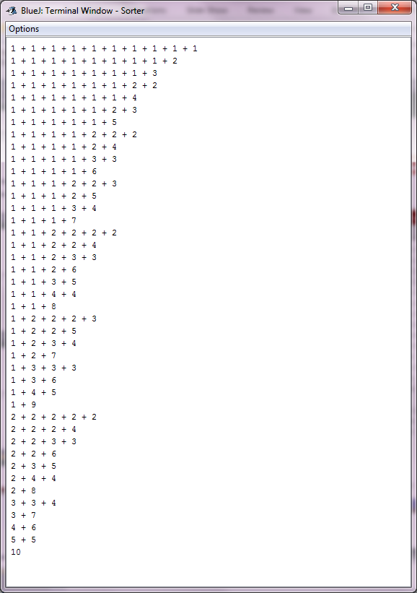
Partitions of 10

